Slide 1
Alabama Alabama Provider Transformation Workshop March 4, 2020
Lakeshore Rehabilitation Facility-ADRS,
201 London Parkway, Suite 450
Homewood, AL 35211

Slide 2
DAY 2 March 4, 2020 Agenda
8:15 am - 8:30 am Welcome and Opening Remarks
8:30 am – 9:15 am Getting Started (Think Big, Start Small, Scale Quickly) Speaker: Genni Sasnett
9:15 am – 10:00 am Your Self-Assessment and Setting Agency Priorities Activity and Discussion
10:00 – 10:15 am BREAK
10:15 am – 11:00 am Case study in Transformation Speaker Tom Wilds
11:00 am – 11:45 am Developing Your Plan Activity and Group Discussion
11:45 am – 12:00 Wrap-up Closing remarks

Slide 3
Getting Started: Think Big, Start Small, Scale Quickly! Development and analysis of pilots, scaling up, initial financial planning and resource reallocation as well as bench marking to meet new priorities
Genni Sasnett, National Subject Matter Expert
Alabama Provider Transformation Workshop
March 4, 2020

Slide 4
Think Big, Start Small, Scale Quickly
Implementing Your Plan:
Piloting
Capacity building
Scaling
Financial Planning

Slide 5
Piloting
Start small w/ interested people but maintain diverse population in the pilot Staff with “early adopter” staff – they will pull others along Determine what you are trying to achieve - measure your performance Make adjustments based on data based information

Slide 6
Analyze Information from Pilot
Determine
activities requiring new sources of funding or expansion of current funding
Identify
sources of needed funding
Develop
a plan for pursuing those sources

Slide 7
Develop a Timeline for Transformation
JD = job development;
CBDS = community-based day; services
CE = customized employment
2017 | 2018 | 2019 | 2020 | 2021 | 2022

Slide 8
Build Capacity for CIE & Meaningful Community Inclusion
Adequate staffing ratios & availability of staff
Excellent job development capability
Community partners for CBDS & CIE
Cloud-based electronic data-based systems
Communications devices and systems
Policies and Procedures for community
Revamped staff development and training strategies

Slide 9
Forecasting predicting future costs and resource requirements

Slide 10
Budgetary Projections
You will go back and forth between planning operationally and reconciling budgetarily
Best to develop projected budgets for the duration of your strategic or transformation plan (3 yr. plan = 3 yr. budgets)
You may have a shortfall initially, however, projections made after programmatic and structural changes should begin to show positive financial outcomes
Notes:
You must do some fundraising to bridge the gap

Slide 11
Scaling Up
Determine structure, policies and procedures, required resources
Multi-year plans for expansion with specific timelines – BUT stay opportunistic Try another way – a la Mark Gold – go around barriers Keep everyone informed and involved Alter or adapt approaches but keep within parameters of beliefs Begin to formalize procedures across the board Focus on quality and individual outcomes for people

Slide 12
Transition from Facility-Based to Community-Based Services
1.) Ensure pilots have been completed and new services established
2.) Ensure personnel is in place. (employment, wrap-around & case management)
3.) Close the “front door” to referrals to 100% facility-based services
4.) Set dates and hard numbers for transition (X # into CBDS or CIE)
5.) Begin working w/ Support coordination for funding for CBDS or referral process to ADRS for employment
6.) Begin planning for wrap-around support for those who are working , if required

Slide 13
Think Financial Agility!
Use caution before locking in long term financial commitments
Purchases of property or facilities
Long–term leases without kick-out clauses
Vehicles & Equipment - think “leasing”
Think decentralized services
Think electronics for efficiency

Slide 14
Decentralized Services & Technology
Decentralized Services
Technology
Plan for fewer people coming to central locations (facilities)
Consider impact of less travel, less need for large facilities and associated costs
People served closer to home, better connection to natural supports
Initial investment required
Staff untethered from facility – can do work anywhere, fewer offices
Efficiencies achieved

Slide 15
Consider Case Mix
Do you have a diverse group of individuals on your case loads?
Analyze the support levels of the people you currently support
Analyze the support levels of the referrals you are receiving – what do they tell you?
Solicit a wider range of clientele – some with fewer support requirements as well as those with greater needs
Develop “mixed“ caseloads for employment specialists
Consider other populations and referral sources
Consider specialization among employment staff, while allowing for flexibility in how staff are deployed

Slide 16
Some quicker placements possible - May be able to make placements sooner with people with fewer challenges to employment
Can balance financially - earning profit with some job seekers and experiencing loss with others
Employment staff experience success more frequently, highly motivating
Caution!!! - must have means to ensure equitable access to employment services for all

Slide 17
Resource Reallocation Moving on Two Tracks

Slide 18
Assessing the Difference in Current Resources and Future Resource Requirements
This Photo by Unknown Author is licensed under CC BY

Slide 19
Impact – Resources Stretched

Slide 20
What Does All of This Mean?

Slide 21
What That Means
Something’s got to give!!!
Notes:
You only have so much money and these things cost so something has to give

Slide 22
Bridge Funding
Not likely to get from government
Private fundraising for targeted resources

Slide 23
Development
Individual giving
Planned Giving
Events
Grant proposals

Slide 24
Look for Efficiencies

Slide 25
Measure Your Progress
Identify what to measure and why
Determine how you will measure
Develop benchmarks for future performance

Slide 26
Summary
Think Big, Start Small, Scale Quickly! Use piloting as an essential tool in transformation.
Research funding, think diversification and optimization of current funding
Use experience to forecast and plan for the future
Consider cost savings associated with decentralization of services and increased use of technology
Think carefully about how you are using current resources and develop appropriate resource allocation to achieve goals

Slide 27
Discussion Group 1
Has your agency undertaken any pilot projects as a method of learning about the effectiveness of and resources requirements for new services?
If not, do you plan to?
What did you learn if you have already conducted a pilot or what will you hope to learn if you plan to conduct one?

Slide 28
Discussion Group 2
What resources are needed for community based employment and day service provision that may be different from facility based ones?
Has your agency begun to plan for those? What’s the plan?

Slide 29
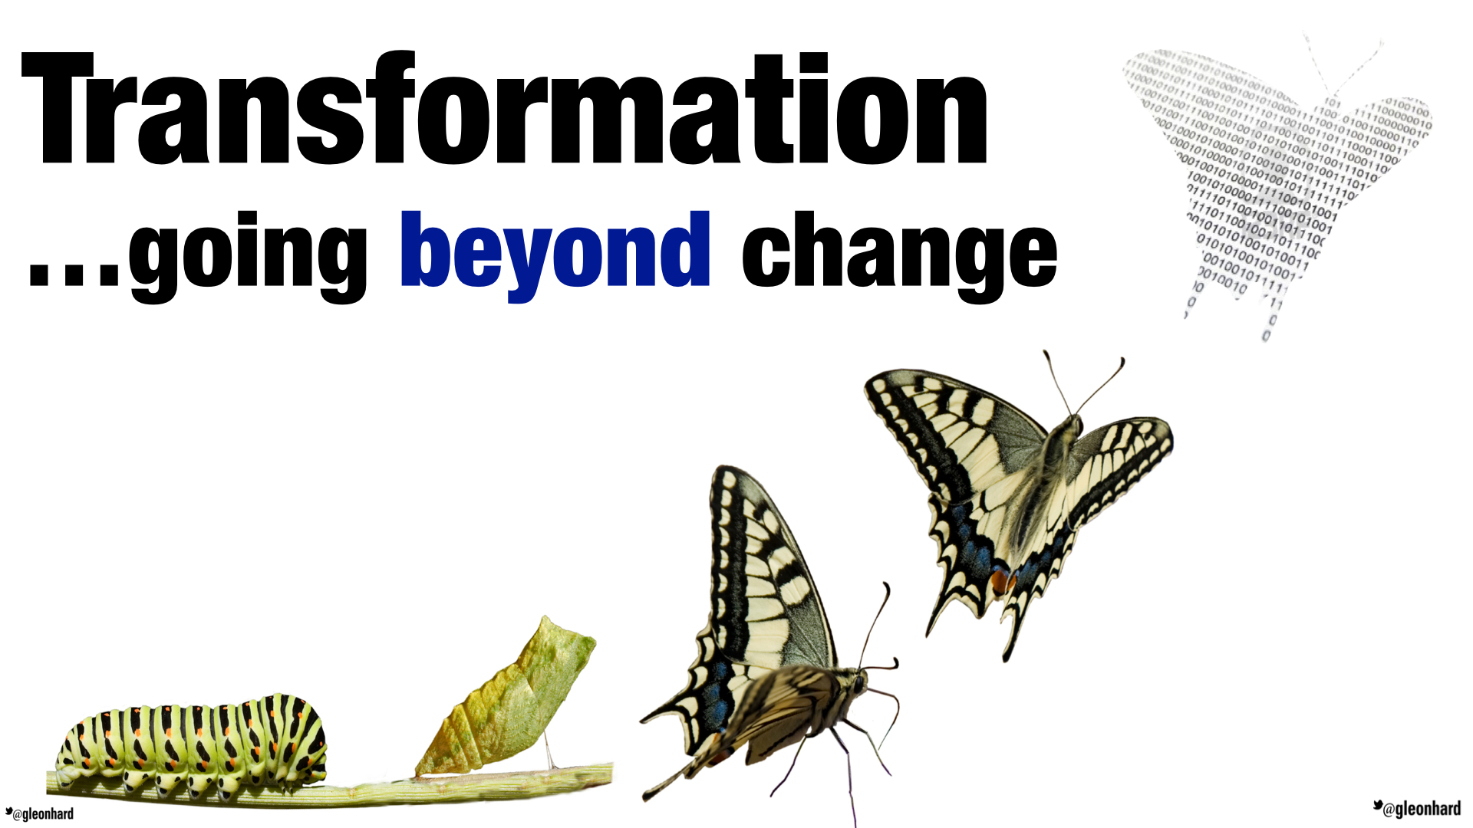
Group Discussion 3
Can you identify some possible efficienciesyour agency could implement that provide opportunities for resources reallocation to finance your

Slide 30
Group Discussion 4
What data do you need to keep in the field for billing? How is that transmitted?
What data is kept for measurement of acquision of outcomes, both for Individuals and for the agency?
How is the data used for manage services provided?

